Slide 1







BACCEIC & ERIC South
Fall Sub-fund Meeting
Wednesday, October 7, 2026
Virtual | 12:00 PM to 1:30 PM
Public Employers:
What You Need to Know

Slide 2



WELCOME
Al Kirk
BACCEIC Sub-fund Administrator
ERIC South Sub-fund Administrator
Partner, Conner Strong & Buckelew

Slide 3

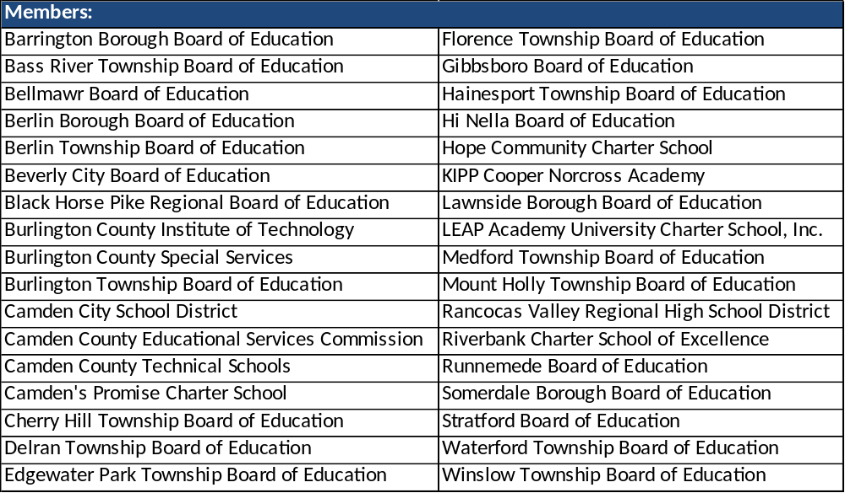

WELCOME BACCEIC MEMBERS

Slide 4
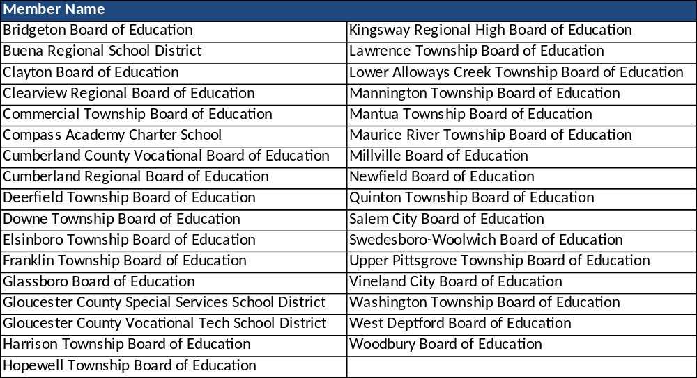
WELCOME ERIC SOUTH MEMBERS

Slide 5
1.5 QPA Credits:
Continuing
Education
Credits
  1.5 Office Admin / General Duties
Certificates will only release at the end of the program and receipt of Completed Evaluation Form.
Must be present for the entire program.
REMINDER!
1 = GOOD/AGREE
4 = BAD/DISAGREE

Slide 6

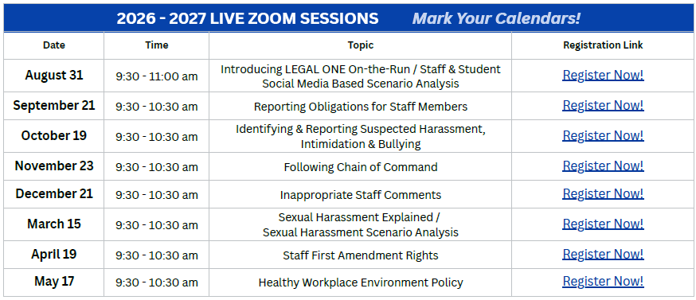



*NEW VALUE-ADDED SERVICE*
https://njpsa.org/legal-one-on-the-run-loor-njsig/
Use the link above to register for live training, access each presentation and session recording, access Key Takeaways, Suggested Discussion Questions, Considerations, Assessments, and Study Plans for each topic.

Slide 7



2026 NJSBA Workshop
October 19-22, 2026
Visit us at:
Booth #740
Booth #465

Slide 8








PEER to PIER Networking Event
Tuesday, October 20, 2026
5:00 – 7:00PM
Landshark Bar & Grill
133 Boardwalk, Atlantic City, NJ 08401
Join fellow education leaders and industry partners for an evening of networking, collaboration, and professional connections following the NJSBA Workshop. Enjoy light bites and drinks while connecting with peers and industry partners.
Event Hosts:

Slide 9
SAVE THE DATE
Please save the following dates for future sub-fund meetings:
BACCEIC & ERIC South
January 27th
May 5th
Seeking Volunteers for Sub-Fund Advisory Committee

Slide 10
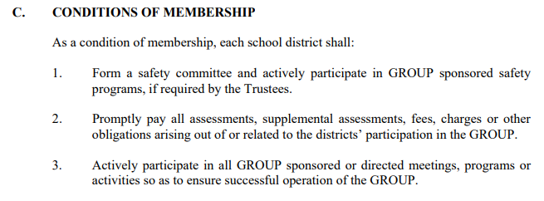


NJSIG – Bylaws
Resource: Access the MEL Safety Institute for sample forms and checklists, such as Model Safety Committee Meeting Agendas, Investigation Worksheets, Self-Assessments and Training Guides.
https://melsafetyinstitute.org/forms-checklists

Slide 11

NJSIG Update
Joe Semptimphelter
Senior Business Development Specialist
jsemptimphelter@njsig.org

Slide 12



MEMBER SERVICE & PARTNERSHIP
MEMBER-CENTRIC SERVICE:
Training and Education:
    Safety committees
    Online & in-house training
      Vector Solutions
    Defensive driving training
    Workers’ compensation training
  Inspections:
  Property: Every 5 years
  Playground: Annual (by request)
  NEW: Pre-QSAC Inspections!
  Valuation Services / Appraisals:
  Every 4 years via CBIZ

Slide 13

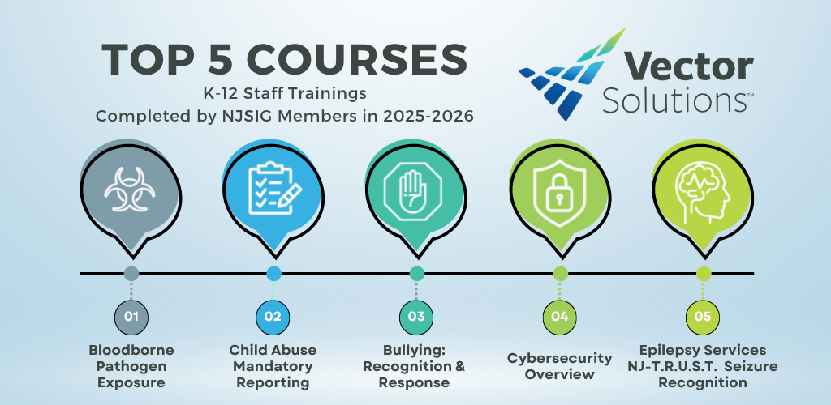
Vector Solutions
Included with NJSIG membership:
100% K-12 school-focused trainings
Library of over 300 courses
Staff completion reports available on demand
Offers many courses required by the New Jersey Department of Education
Quick Reference Guide to assist with assigning trainings

Slide 14
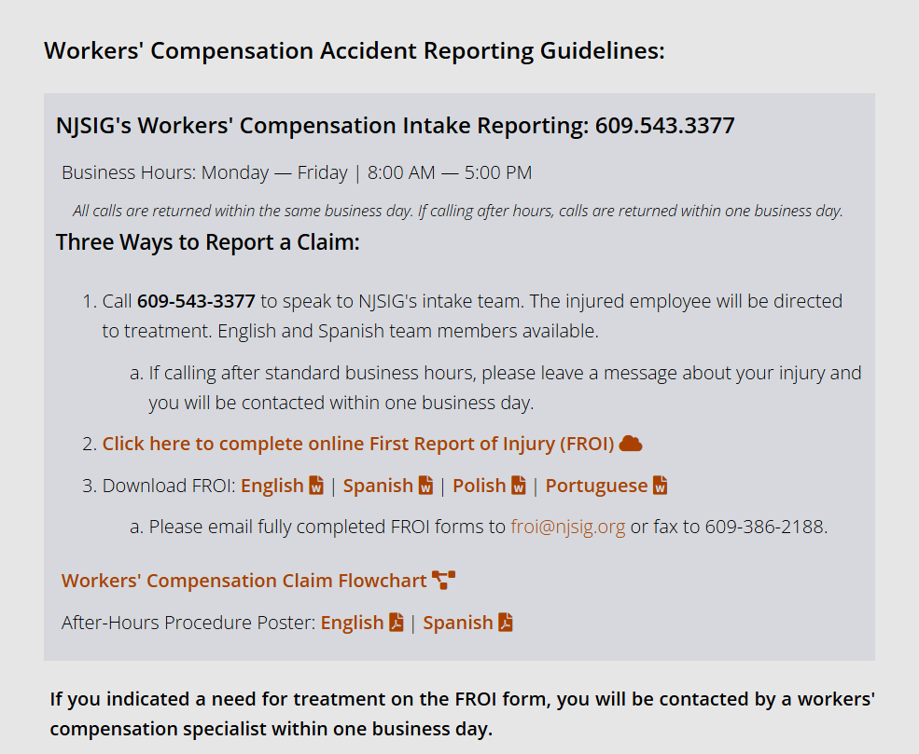
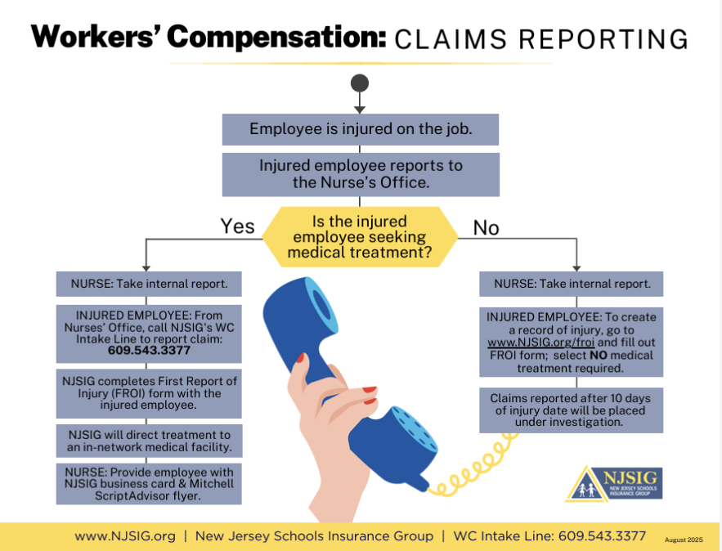
Worker’s Compensation
Claims Reporting Training
All materials can be found: https://www.njsig.org/reporting-claims#workerscomp

Slide 15

The NEPHA Hotline
NJSIG Employment Practices Hotline Attorney (NEPHA)
Operated by Cleary, Giacobbe, Alfieri and Jacobs
Only a superintendent, BA, or HR manager may make contact
Open to all districts that have errors & omissions (E&O) coverage
Valuable, no-cost resource for expert guidance
Answers to specific employment-related questions
Deductible waived when districts seek hotline guidance before an E&O claim and follow the advice provided.

Slide 16

NJSIG @ NJSBA Workshop 2026
NJSIG Presentations
Board Ethics: Risks & Realities Presenters: Sherwin Archibald Rita Barone, Esq. Tuesday, October 20, 2026 9:30am – 10:30am 1:00pm – 2:00pm Room 420 Continuing Education Credits: .5 Board member Academy 1 Qualified Purchasing Agent – Ethics | Navigating Special Education Claims: Pitfalls & Best Practices Presenters: Anthony Fernandez Eric Harrison, Esq. Wednesday, October 21, 2026 11:30am – 12:15pm 2:00pm – 2:45pm Room 313 Learning Lab Continuing Education Credits: .25 Board member Academy

Slide 17

PRESENTATION
Brian Maitland
Director of Safety Services

Slide 18

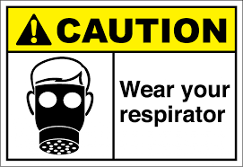
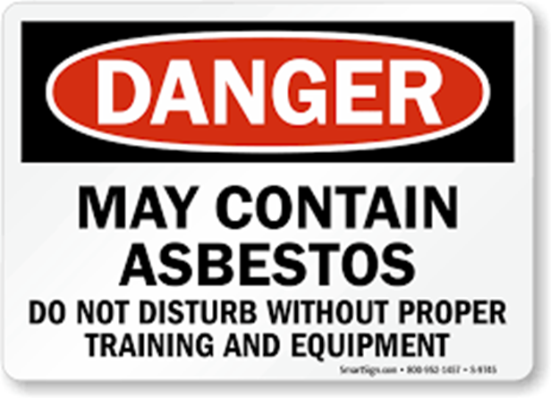

Public Employers
What You Need to Know
Notes:
Class version: 2025; Class duration: 1½ hours
There is 1 built in breaks
July 2021

Slide 19
Objective
At the conclusion of this session attendees will understand the responsibilities of the employer to its employees to create a safe and healthy work environment and how to best manage risk exposure as a Public Employer.

Slide 20
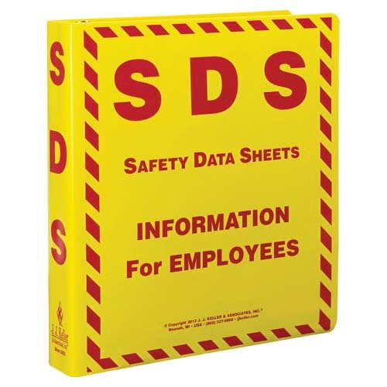

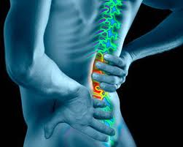
Today’s Class
Regulatory
Employer Responsibilities
Risk Control
Notes:
Regulatory:
Hazard Communication/Right to Know
Bloodborne Pathogens
Fire Safety
Fire Extinguishers
Personal Protective Equipment
Asbestos/Lead/Silica
Common Hazards:
Back Safety
Confined Space Awareness
Fall Protection
Ladder Safety
Lock Out / Tag Out
Mower Safety
Snow Removal
Walking & Working Surfaces
Best Practices:
DOA/wellness checks
Crime scenes
Reporting hazardous conditions
Vacant apartments

Slide 21
Elements of a Safety Program
Support from upper management
Regulatory written programs
Facility inspections
Safety training
Job Safety Observations (JSO)
Safety Committees
Accident / injury investigations

Slide 22

Regulations - OSHA
With the Occupational Safety and Health Act of 1970, Congress created the Occupational Safety and Health Administration (OSHA)
OSHA’s purpose is to ensure safe and healthful working conditions
Sets and enforces standards
Provides training, outreach, education and assistance

Slide 23

Regulations – NJ PEOSH
Public Employees Occupational Safety and Health (PEOSH) develops and enforces occupational health standards for public employees in New Jersey
Encourages employers and employees to improve their working environment
Will enforce OSHA Regulations

Slide 24

PEOSH Inspection
Inspections can be:
Programmed Inspection
Complaint Response
Injury or Fatality Investigation
Consultation

Slide 25
During PEOSH Inspection
Complaint and Programmed Inspections will be unannounced & during business hours
Except when:
  An imminent danger
  Can only effectively be conducted after hours
  To ensure someone is present at facility
PEOSH Inspectors:
  Have the right to privately interview employees
  Have the right to question employees

Slide 26
Inspection Process
Inspector Identification & Credentialing
Opening Conference
Escorted Walk-around
Closing Conference
You may deny entry, but they may return with a warrant.

Slide 27
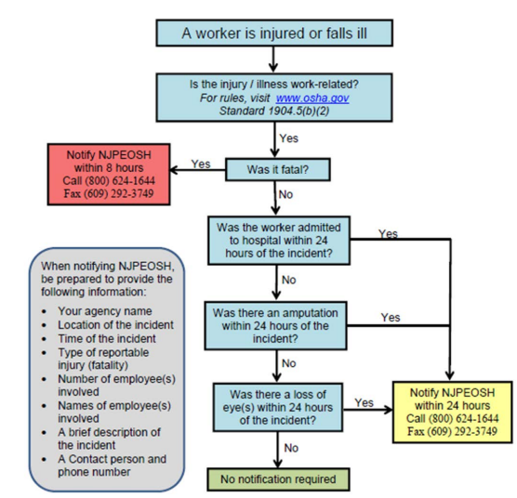
Reporting Injuries/Illnesses
Notes:
New Jersey Public Employers must report fatalities to NJPEOSH within eight (8) hours of the occurrence and report work-related hospitalizations, amputations, or loss of an eye within 24 hours by calling the 24-hour hotline (800)624-1644 or the 24-hour fax line (609)292-3749.

Slide 28
Annual Reporting
Recordkeeping –NJOSH 300 Forms 1904.29(a)
  Must record info about every work-related death and work-related injury or illness involving:
    Loss of consciousness
    Restricted work activity/job transfer
    Days away from work
    Medical treatment beyond first aid
    Significant injuries/illnesses diagnosed by physician or LHCP.

Slide 29
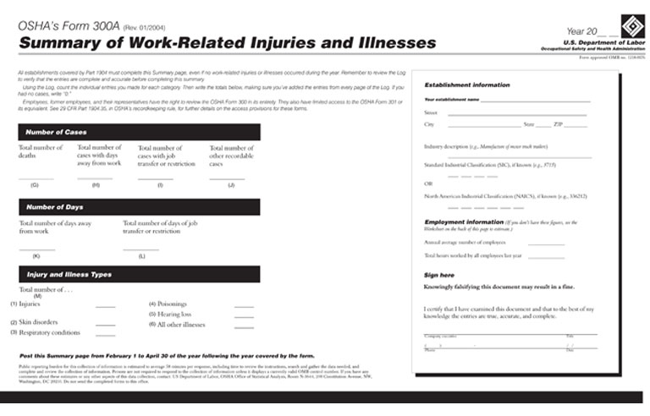
Annual Reporting
  Complete Summary of Work-Related Injuries and Illnesses
  Post the Summary page from February 1 to April 30 of the year following the year covered by the form

Slide 30
Employers Must Protect Employees by Providing
Engineering Controls
Work Practice Controls
Personal Protective Equipment
Eliminate process
Substitute safer process
Redesign process
To the extent ‘feasible’
Safer policies
Safer practices
Training
To the extent ‘feasible’
LAST RESORT
PPE does not remove hazard
Training critical
  Selection
  Limitations
Notes:
Explain that they will see this concept in many of the topics we will be discussing. Hazcom, bbp, ppe, etc.

Slide 31
Regulatory Requirements
Hazard Communication
& Right-To-Know

Slide 32
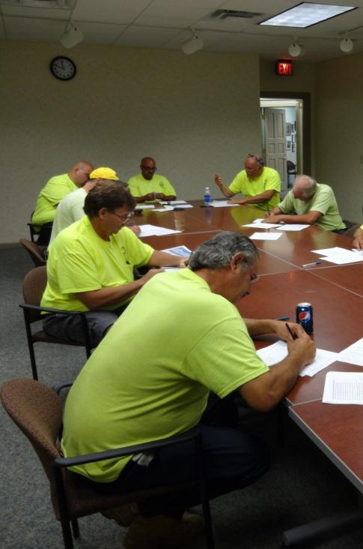

Principles of Hazard Communication & RTK
Labeled Containers
Accessible Information
Effective Training
Notes:
One point of confusions is that the regulations all are based on the same 3 principles:
People have to know what they are working with. In other words, there must be a label that tells what is in the container.
There has to be information available that can explain the hazards of the material
And for OCCUPATIONAL chemical safety, workers must be educated to use and understand the information.
If these three things are in place, the worker has the necessary tools to protect themselves, their co-workers, and their families.

Slide 33
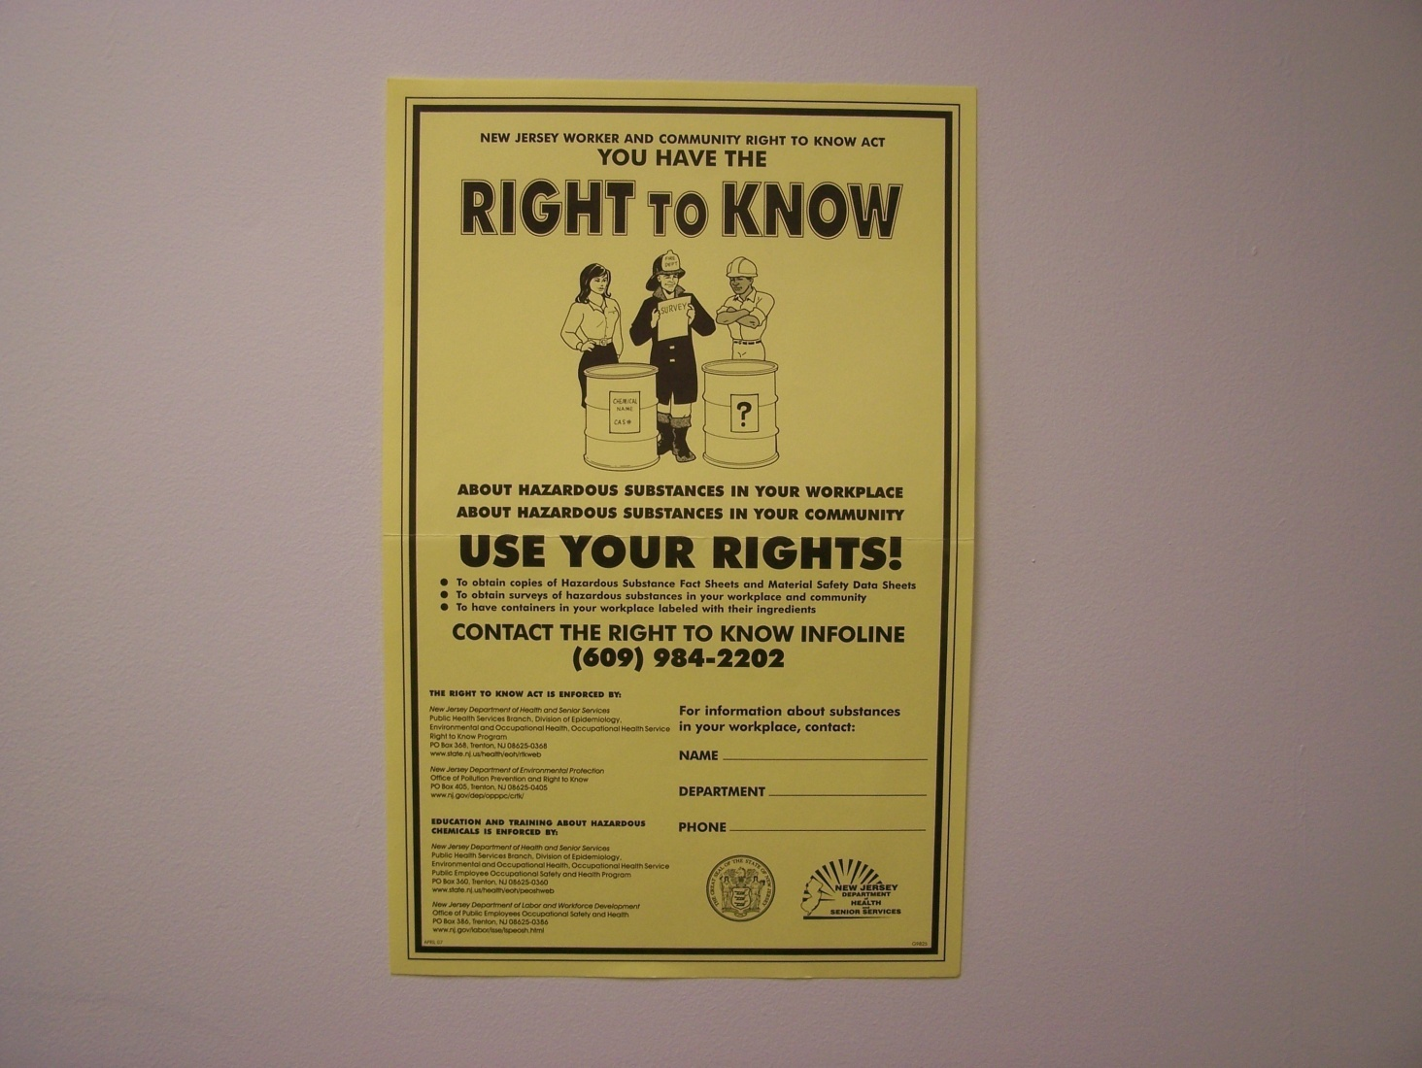
Employer’s Obligations & Worker Rights
Employers must:
  Inventory chemicals
  Maintain chemical data sheets
  Evaluate chemical hazards & institute safeguards
  Display RTK poster
  Develop a written program
  Submit RTK survey (July 15th)

Slide 34
Employer’s Obligations & Worker Rights
Employers must
  Educate and train workers
    Right to understand chemical hazards & safeguards
    Right to file complaint
    Right to medical records

Slide 35
Labels – HazCom versus RTK
HazCom & GHS Label
Right to Know Label
Name or identifier
Name, address & phone # of manufacturer / supplier
Hazard class
Pictogram(s)
Precautionary statement
Signal Word
Name or identifier w/ CAS #
Name, address & phone # of manufacturer / supplier
Hazard (words or pictures)
Warnings
5 most predominant ingredients AND any hazardous ingredients with CAS #
}
}
Notes:
New Jersey requires both HazCom / GHS and RTK information to be on labels used by NJ public employers. For a large part the two lists are similar. The 2 big differences are:
NJ requires a list of ingredients that is more extensive than HazCom.
GHS places a greater emphasis on standardization. That the definition of a flammable is the same no matter where you are, and who wrote the SDS. Before GHS, definitions of flammable, poison or corrosive would often vary by country.

Slide 36
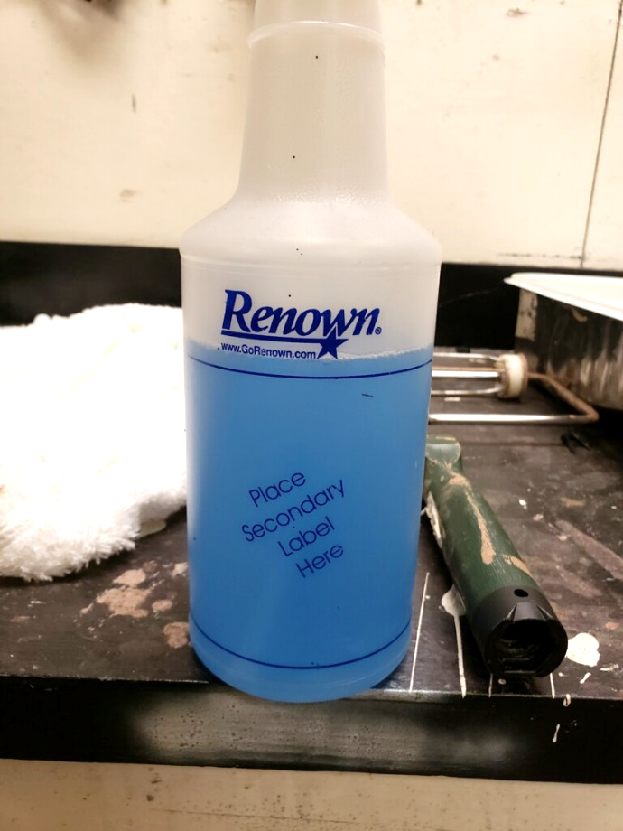
Secondary Containers
Transferring a chemical from its original container into another container
Must be labeled with all HazCom & RTK information
Unless the container is under sole control of one person during 1 work shift

Slide 37
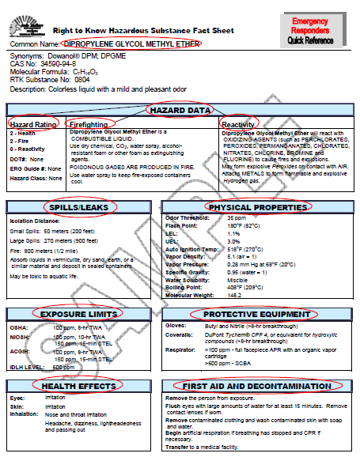
Hazardous Substance Fact Sheets
By NJDOH
~ 1600 common substances
Available at NJDOH website
Standard 6-page format
  Page 6 contains emergency information
Notes:
Fact Sheets are prepared for substances on the New Jersey Right to Know Hazardous Substance List. More than 1,600 Fact Sheets have been completed and more than 900 have been translated into Spanish. The Fact Sheets are prepared on pure substances and contain information on health hazards, exposure limits, personal protective equipment, proper handling, first aid, and emergency procedures for fires and spills

Slide 38
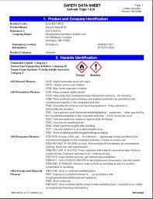
Safety Data Sheets
By the manufacturer
For every hazardous material
Gives:
  Physical characteristics
  Routine work procedures
  Emergency measures
Standard 16 Section format
Notes:
The GHS replaces Material Safety Data Sheets with SAFETY DATA SHEETS. The information is the same, but the SDS is required to be organized into 16 defined sections. That’s a benefit to the worker looking for information.

Slide 39
Regulatory Requirements
Bloodborne Pathogens

Slide 40

Bloodborne Pathogen
Microorganism in blood, or other-potentially-infectious material (OPIM) which can cause a disease.
  HIV/AIDS
  Hepatitis B
  Hepatitis C
1910.1030 does not cover diseases transmitted via
  Respiratory droplets
  Food-borne
  Rodent / bird / insect
  Casual contact
Notes:
OSHA only a safety standard for BLOODBORNE PATHOGENS. We know there are diseases in other vectors, such as respiratory droplets (SARS, TB, flu), Food (botulism, Hep A & E), rodents/birds/insects (Lyme, Plague, Hantavirus) and even casual contact (MRSA).
Employees really need to think just the blood transmission possibility and think to protect themselves from all infectious sources. The good news is many of the strategies to protect yourself against blood will also help against other transmission vectors.

Slide 41
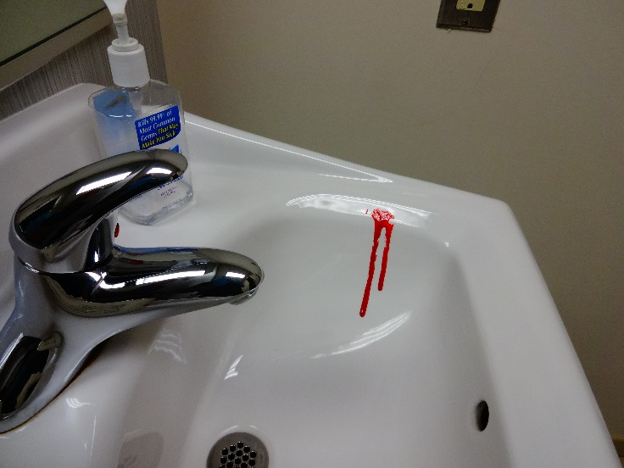
Tasks with Potential Occupational Exposures
Cleaning restrooms & playgrounds
Handling solid waste
Cleaning apartments after accidents

Slide 42
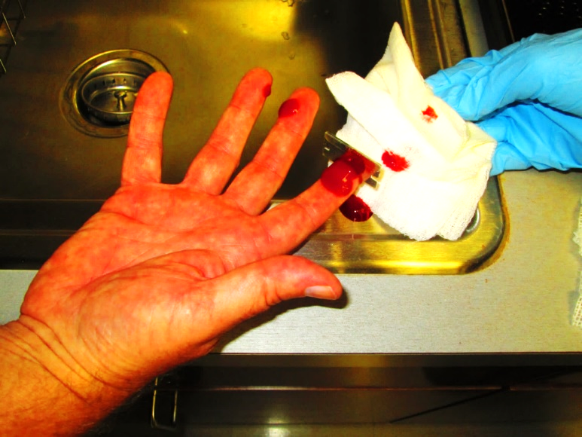
Good Samaritan First Aid
One co-worker helping another
Not as part of job duty
Desire to help
Not included under the BBP Standard
Employees exposed to bodily fluids when administering care should be offered post-exposure evaluation and follow-up
Notes:
Good Samaritan First Aid is when an employee who is not required to provide first aid as a part of their job duties, administers first aid to an injured person, out of the goodness of their heart. This act is not considered a potential occupational exposure since it is not part of the employee’s job duties, and therefore the employee is not covered by the provisions of the BBP Standard.
However, if the employee is exposed (or potentially exposed) to blood or bodily fluids, the employee should be given the same post-exposure evaluations and necessary treatment as an employee who is covered under the Standard.

Slide 43
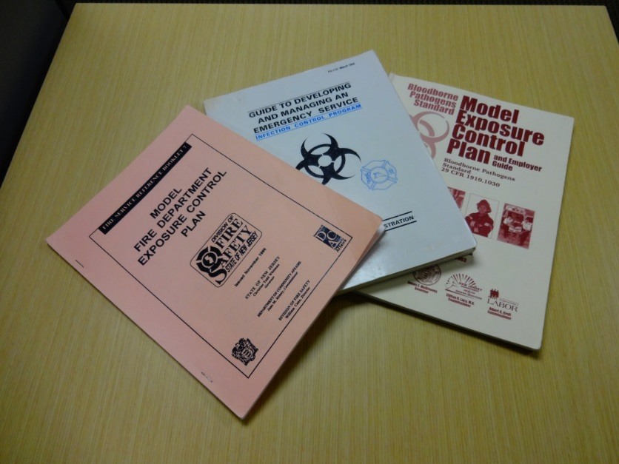
Exposure Control Plan
Employers with a potential exposure to their workers will have an Exposure Control Plan
Must be readily available to all employees during working hours
Must be reviewed and updated annually
Model Exposure Control Plans

Slide 44
Exposure Control Plan Contents
Program Administrator
Workplace exposures (job titles & tasks)
Training and Vaccination Procedures
Engineering, Work Practice Controls, PPE
Clean-up and Decontamination
Post-exposure follow-up
  Reporting procedures for normal work hours
  After-hour reporting procedures
Notes:
Most of the plan is dedicated to identifying and controlling job tasks that may expose the worker to blood and OPIM.
It should tell employees how jobs can be done to safeguard their health
Towns may have incorporated Engineering Controls such as purchasing self-retracting syringes for the Health Dept.
Towns may have incorporated Work Practice Controls such as an ordinance requiring all trash be in trash cans with handles, thereby removing the common hazards of getting stuck with a needle when picking up a trash bag.
When and when PPE is required such as when wiping down sinks & counters in parks’ restrooms
The plan must also include what an employee must do if an exposure does occur, despite our precautions. Including:
Who and where to report an exposure – remember an Exposure also includes POSSIBLE contact with blood & OPIM
After hours also – many departments (PD, FD, EMS, etc.) are 24/7 and also many DPW tasks (snow plowing, weekend work, clean-up after late meetings, etc.) are done after normal business hours. There needs to be a policy developed and made known to workers on how to get help when supervisors are not immediately available. Typically this to report to the nearest hospital.

Slide 45

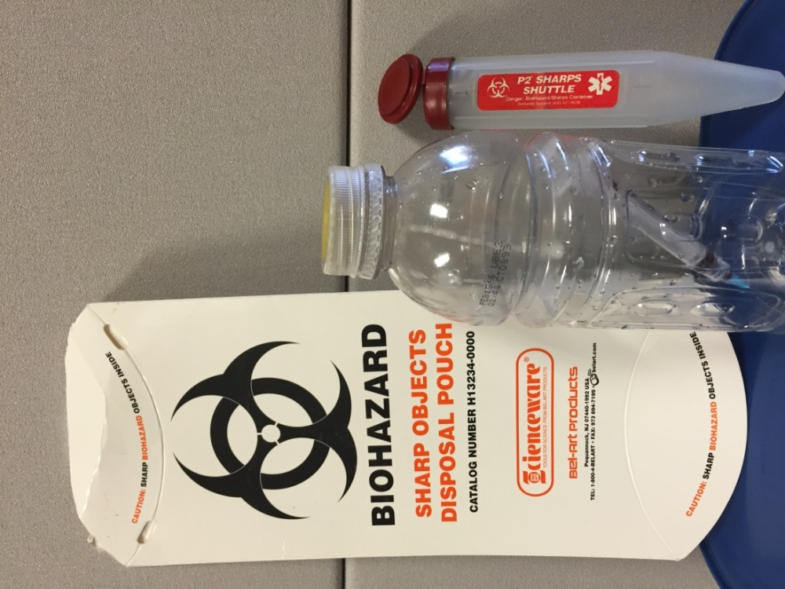
Engineering Controls
Handwashing Facilities
Puncture-resistant and drip-proof
Red in color
Labeled with Bio-Hazard symbol
Small opening in top
Locking lid
Notes:
Three examples of engineering controls - options for Sharp Shuttles

Slide 46
Administrative Controls
Policies & Procedures
Training – based on job duties
  Initial, before first assignment with exposure
  Annual refresher
  OSHA-defined curriculum
    General provisions
    Site Specific concerns
Notes:
Ask audience for additional Admin Control in their workplace. Some examples might include
Do not store blood or OPIM in refrigerators with food
Do not eat, drink, apply makeup, handle contact lenses, smoke, etc. when working around blood or OPIM
All procedures must be done to minimize spraying or splashing blood / OPIM
Cleaning / disinfection schedules

Slide 47
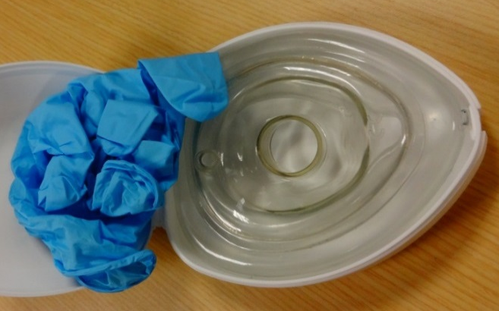
Personal Protective Equipment
  Gloves
  Face Masks, glasses, or goggles
  Gowns or aprons
  Disposable CPR Equipment
    If CPR is a job task
Notes:
Employers must:
Provide personal protective equipment for exposure to blood (i.e., gloves, gowns, laboratory coats, masks, face shields, eye protection, mouthpieces, resuscitation bags, pocket masks, or other ventilation devices).
Purchase appropriate PPE that does not permit blood or other potentially infectious materials to pass through to or reach the employee’s work clothes, street clothes, undergarments, skin, eyes, mouth, or other mucous membranes under normal conditions of use and for the duration of time which the protective equipment will be used.
Insist that gloves be worn when contact with blood, mucous membranes, other potentially infectious materials (OPIM), or non-intact skin is anticipated, and when performing vascular access procedures, or when handling contaminated items or surfaces. Provide designated area or container for PPE storage, washing, decontamination or disposal

Slide 48

Hepatitis B Vaccine
Must be offered to employees with a reasonable risk of exposure to blood or OPIM
Employees may refuse
  Must sign Declination Form
Consider deferring vaccine if
  Severely sensitive to yeast
  Currently ill
Can change your mind ANYTIME

Slide 49

Regulated Medical Waste
Waste That
Is saturated or caked
Releases blood when compressed
Used syringes
Disposal
Biohazard disposal bags
Marked with biohazard symbol in RED
Leak-proof container (& puncture-proof for contaminated sharps)

Slide 50
Exposure / Potential Exposure
Exposure Control Officer (supervisor)
  Determines if exposure occurred
If Exposure or Potential Exposure occurred
  Complete Exposure Report Form
  Send employee for medical consultation
  Complete OSHA 300 Log
Medical records kept for employment + 30 yr.

Slide 51
Regulatory Requirements
Fire Safety & Fire Extinguishers

Slide 52
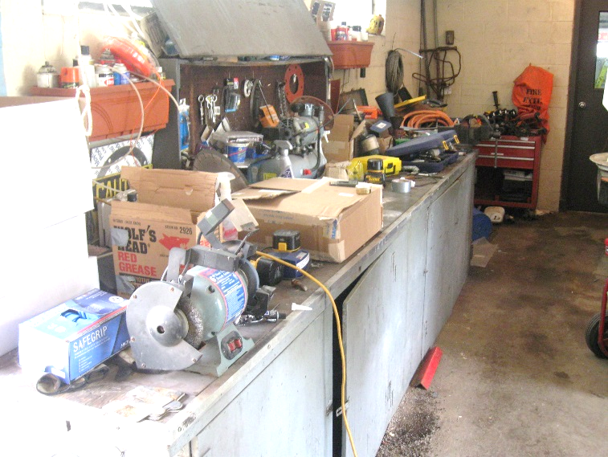
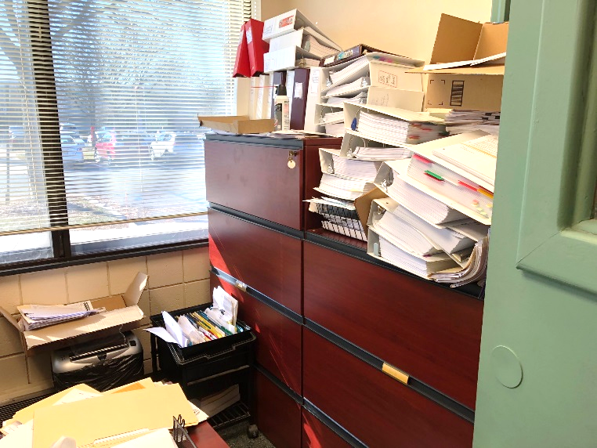
Good Housekeeping
Good housekeeping is the simplest control for this hazard.
Limit the amount of combustible material in your work area
Notes:
Good housekeeping is the simplest control for this hazard.
Limit the amount of combustible material in your work area

Slide 53
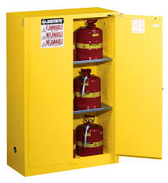
Storage of Flammable Liquids
Safety Cans
Tight-fitting, spring-loaded (self-venting) caps
Can be metal or plastic
Up to 5 gallons
Fire Cabinets
60 gal. of Category 1,2, 3 flammable liquids
120 gal. of Class 4
Notes:
Employers often provide safety cans and fire cabinets. USE THEM.

Slide 54
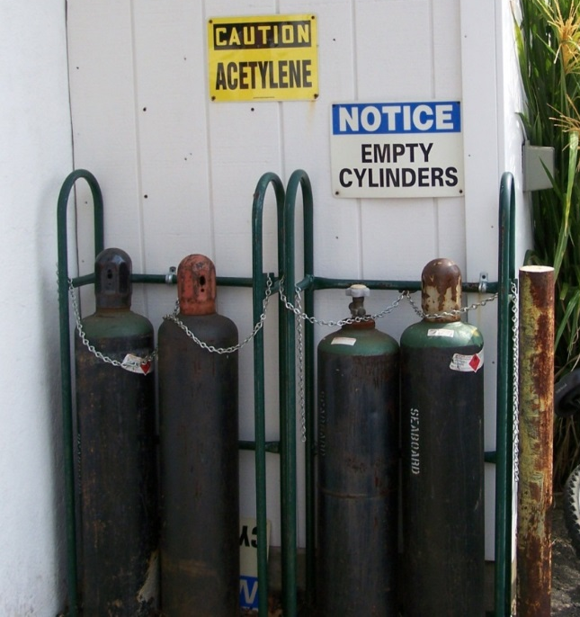
Compressed Flammable Gases
Store oxidizer cylinders, such as
Oxygen
Chlorine
at least 20 feet from flammable gas cylinders
Propane
Acetylene
MAPP
Notes:
Store cylinders containing oxidizers (such as oxygen or chlorine) at least 20 feet from cylinders containing flammable gases (such as propane, acetylene or MAPP).

Slide 55
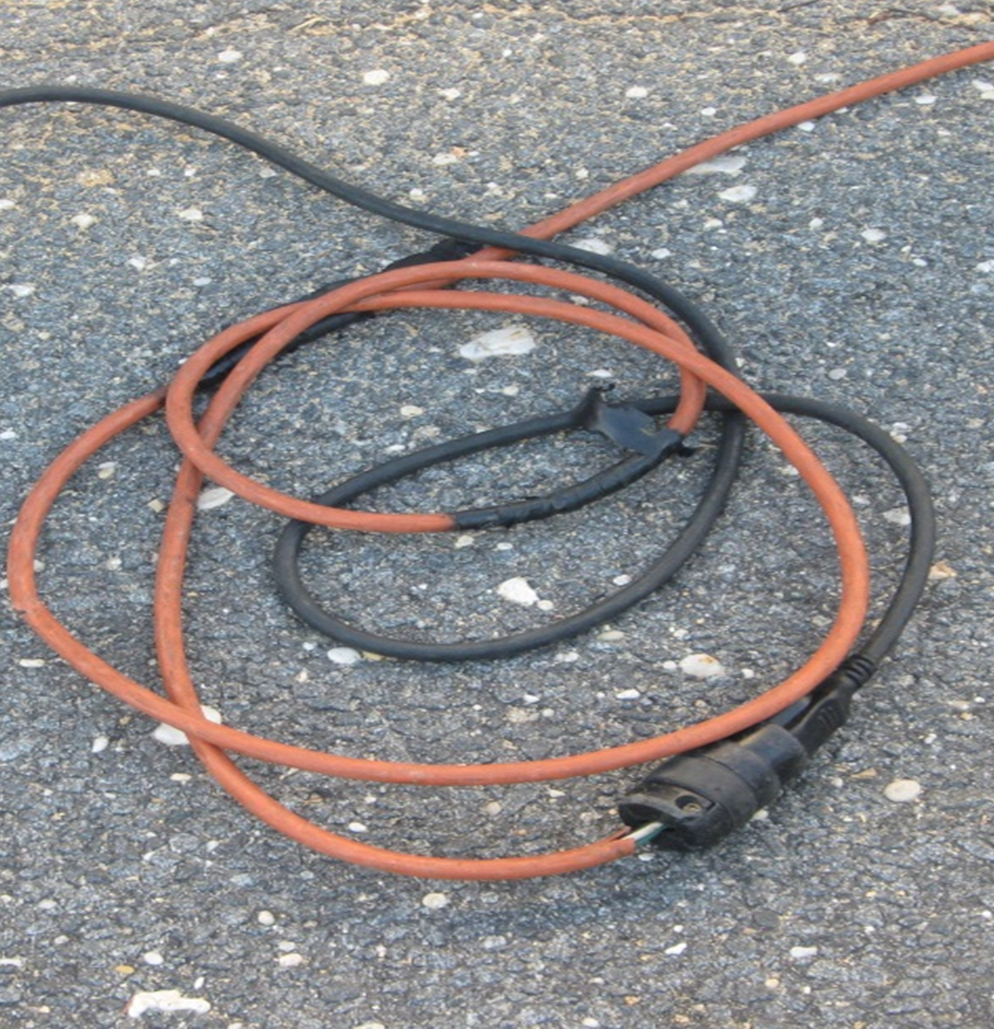
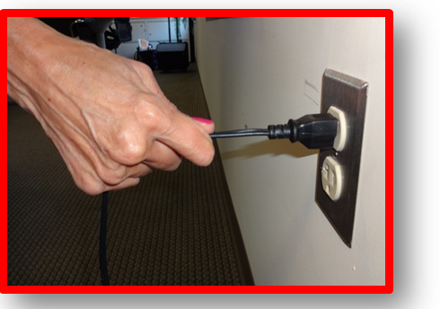
Electrical Safety
Inspect & replace damaged, worn, or improperly repaired electrical cords

Slide 56
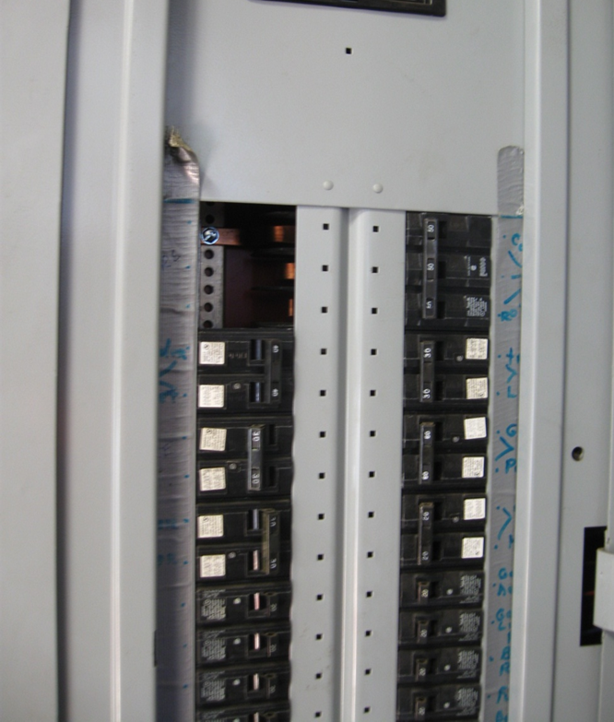
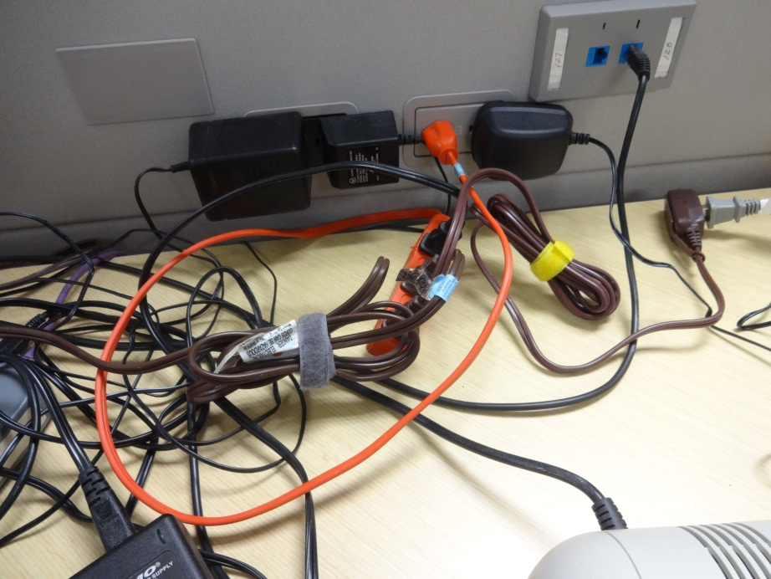
Electrical Safety
Cover openings in electrical boxes
Do not overload outlets or extension cords

Slide 57
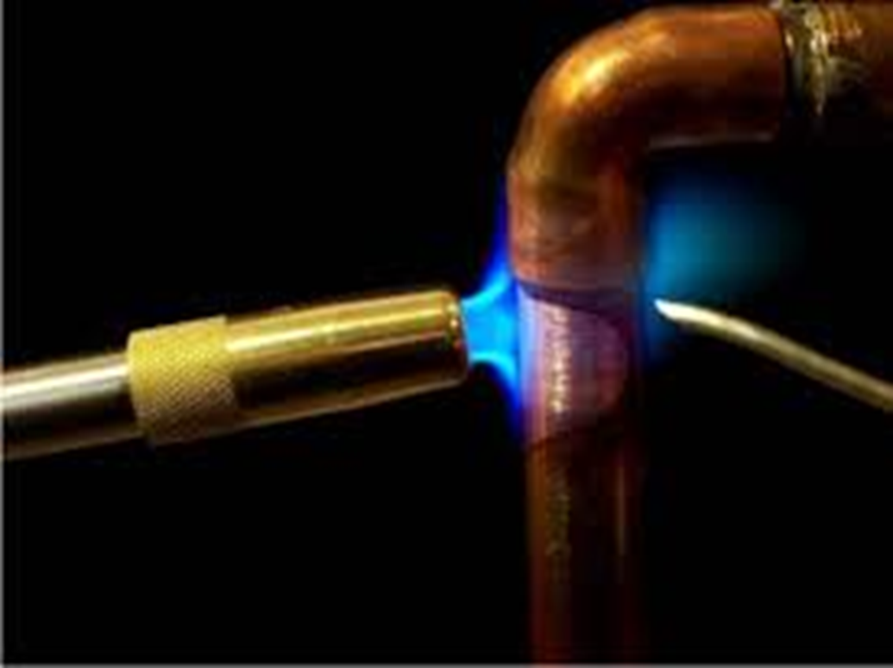
Hot Work Requirements
  Clear or cover combustibles within 35’
    Also consider lower elevations (sparks dropping)
    Extend area for highly flammable or explosive exposures
  Extinguisher immediately available with trained user
  30-minute fire watch
Notes:
NJ Fire Codes requires
Remove combustibles at least 30 feet and
Cover remaining combustibles with flame-resistant tarps
If necessary, wet down
Have a minimum rated fire extinguisher and trained operator
Maintain a fire watch for at least 30 minutes after hot work is completed.

Slide 58
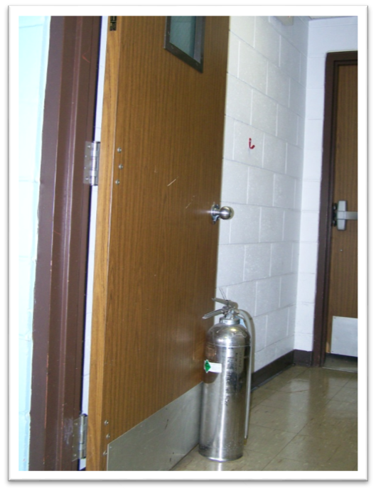
Building Construction
Do Not Alter
Means of Egress
  Travel distance
  Keep clear
  Panic hardware
Compartmentalization
  Fire / smoke doors
  Rated ceiling tiles
  Rated walls
Notes:
Means of Egress
Picture: shows a fire exit blocked with storage, minimizing width of egress
These exit way components act to provide an acceptable level of occupant safety without any actions on their part
Maximum travel distance is established in the Life Safety Code, varies depending on several factors
Egress ways must be kept clear of combustibles and all obstructions which interfere with clear passage
Exit doors must not be locked or require a special key or knowledge to open. Usually open out, though not always required under fire code.
Coconut Grove Supper Club was when we started requiring doors to open out.
Fire Doors, Ceiling Tiles, & Compartmentalization
Fire doors, ceiling tiles, compartmentation all act to contain the fire and minimize the availability of additional fuel sources (the next room). Sealing pipe chases and other holes also do this. This provides a ‘fire rating’ to the room to contain the fire until FD arrives. Fire codes require specific ratings depending on occupancy and other criteria.
If you have to make a hole in a wall, ceiling, floor, etc. make it as small as possible and seal with appropriate fire stopping material. Otherwise you may compromise the ‘fire rating’ of the room.

Slide 59

Fire Sprinkler Systems
Operate one at time
Designed to control fire
Keep storage 18” below deflectors
Do not hang objects from pipes or deflectors
Notes:
A common misconception is that ALL sprinkler heads operate at once. Each sprinkler head opens one-at-a-time when that head reaches a specified temperature, usually 165° F for most offices and areas. Sprinklers are designed to wet and cool combustible materials around the incipient (small) fire so the fire can not spread to more fuels. If the fire goes out, that is a plus.
It is important not to prevent the water spray pattern from the sprinkler head from reaching all areas around the fire. Such as hanging something from the sprinkler pipe or head or deflector. Or putting storage too close to the head so the water spray pattern cannot develop.

Slide 60
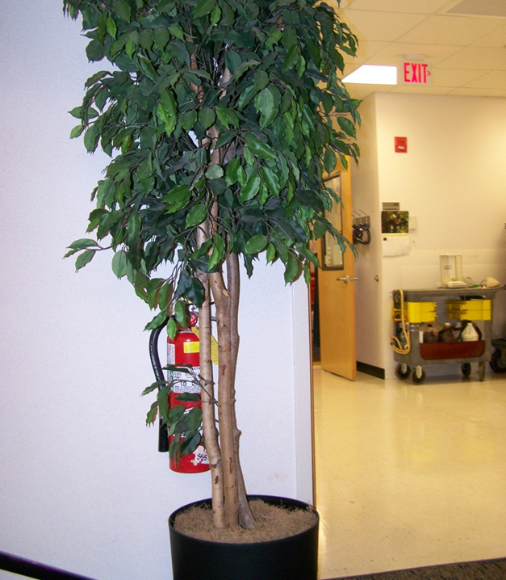
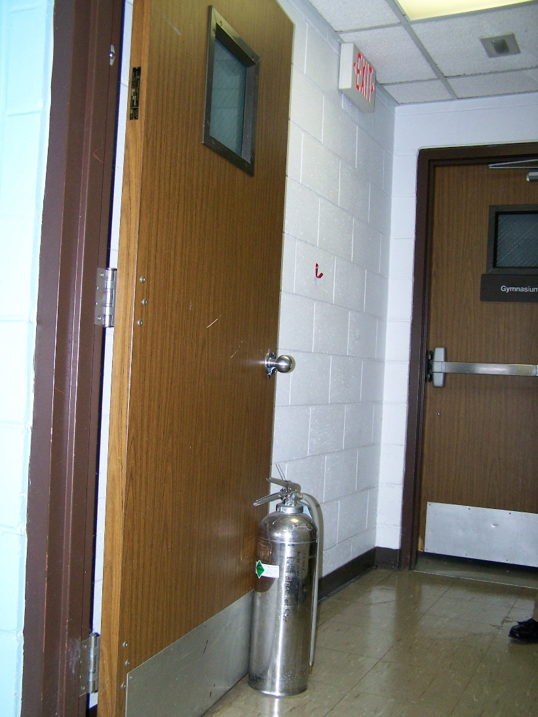
Fire Extinguishers
Do not use extinguisher to block open fire doors
Do not block or visually obscure extinguishers
Notes:
Extinguishers are located so that they are highly visible, usually by exit doors. Extinguishers are ‘just there’. How many times have you walked past a fire extinguisher, without even noticing it? And then there is a fire! Will you, in a highly charged emotional state, remember where it was? Two things:
Do not block it from access or vision.
Do use the extinguisher as a door stop. It’s convenient and reliable, I know. Extinguishers are by exit doors so that IF YOU DECIDE TO USE IT, the exit door is at your back by default. And that door is there to keep smoke and heat out of the stairwell. Now you have created another obstacle for you and your co-workers to safe escape. An open door in the stairwell can create a ‘Chimney Effect’, drawing smoke and fire throughout upper floors quicker.

Slide 61
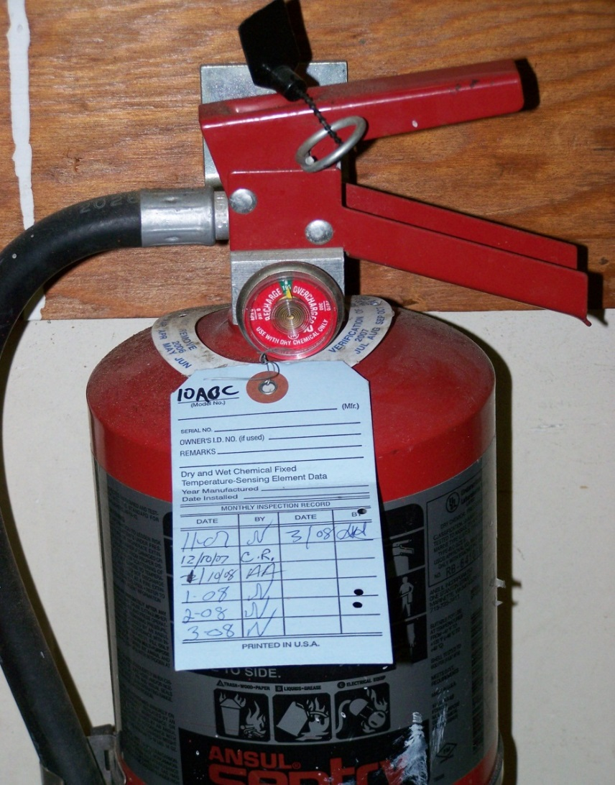
Check Fire Extinguishers Monthly
Mounted & accessible
No obvious physical damage
Pin is in place & seal intact
Arrow in green
Heft (feels heavy, full)
Sign the back of the tag
Notes:
One of PEOSH’s most commonly cited deficiencies is NOT conducting monthly inspections of fire extinguishers.

Slide 62
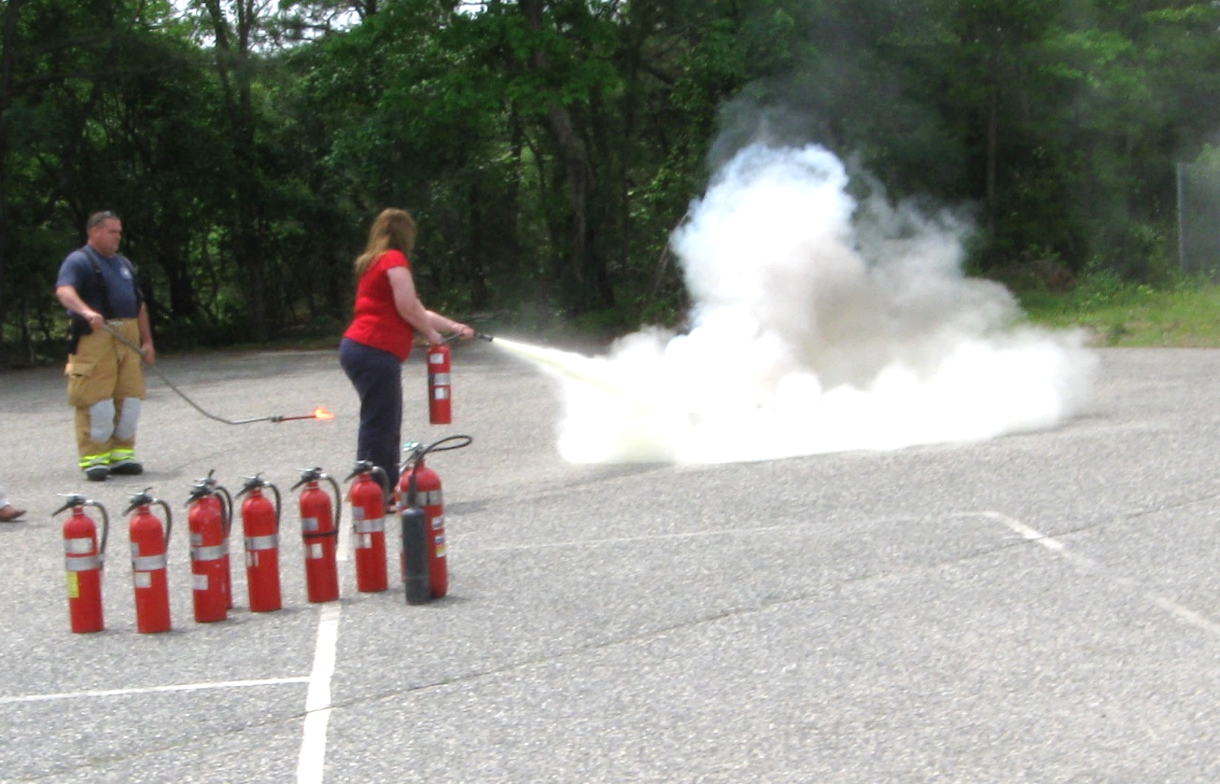
Fire Extinguisher Use
Employers should designate employees who may use fire extinguishers to fight incipient fires.
All other employees should evacuate
Notes:
No requirement that employees must use a fire extinguisher
Most important thing is employee safety
Employer must write a plan to determine if employees will be permitted to use a fire extinguisher, if not all employees must evacuate immediately

Slide 63
Emergency Action Plans
Must be in writing if more than 10 employees
Contains
  Administrator / contact person
  How to report fire and other emergencies
  Evacuation procedures
    Procedures to account for employees
    Critical operations
  Rescue and first aid procedures
  Fire, weather emergency, bomb threat, power outage
Notes:
inimum elements of an emergency action plan. An emergency action plan must include at a minimum:1910.38(c)(1)Procedures for reporting a fire or other emergency;..1910.38 (c)(2)
1910.38(c)(2)Procedures for emergency evacuation, including type of evacuation and exit route assignments;1910.38(c)(3)Procedures to be followed by employees who remain to operate critical plant operations before they evacuate;1910.38(c)(4)Procedures to account for all employees after evacuation;1910.38(c)(5)Procedures to be followed by employees performing rescue or medical duties; and1910.38(c)(6)The name or job title of every employee who may be contacted by employees who need more information about the plan or an explanation of their duties under the plan

Slide 64
Fire Prevention Plan
Must be in writing if more than 10 employees
Contains:
  List of all major fire hazards and storage procedures
  Procedures to control accumulations of flammable/combustible waste materials
  Procedures for regular maintenance of safeguards
  Name of employees responsible for maintaining equipment to prevent ignition of fires
  Name of employees responsible for control of fuel source hazards
Notes:
Minimum elements of a fire prevention plan. A fire prevention plan must include:
1910.39(c)(1)A list of all major fire hazards, proper handling and storage procedures for hazardous materials, potential ignition sources and their control, and the type of fire protection equipment necessary to control each major hazard;
1910.39(c)(2)Procedures to control accumulations of flammable and combustible waste materials;
1910.39(c)(3)Procedures for regular maintenance of safeguards installed on heat-producing equipment to prevent the accidental ignition of combustible materials;
1910.39(c)(4)The name or job title of employees responsible for maintaining equipment to prevent or control sources of ignition or fires; and
1910.39(c)(5)The name or job title of employees responsible for the control of fuel source hazards.

Slide 65
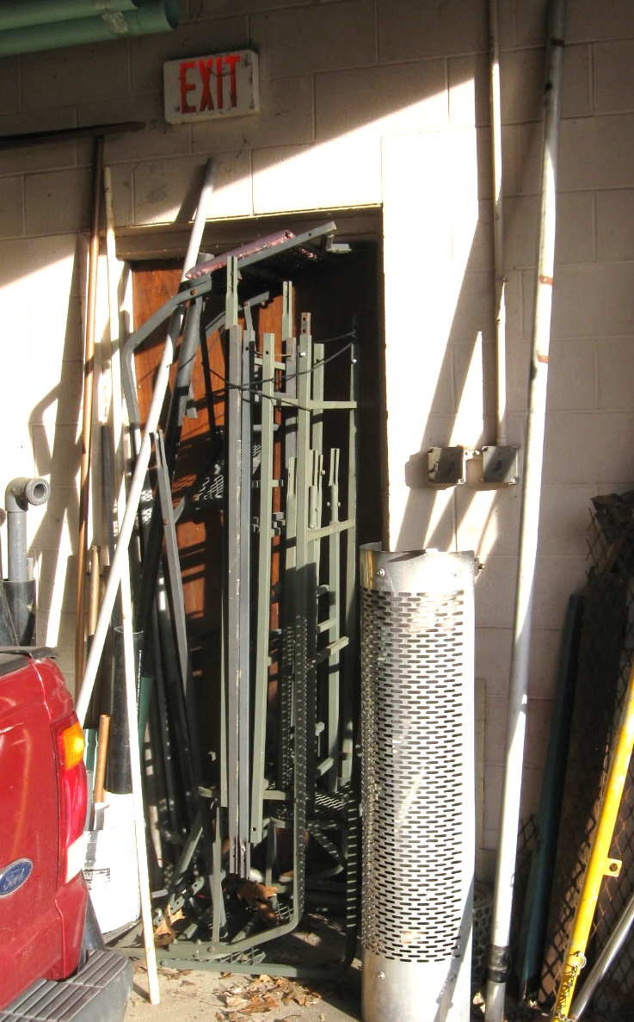
Fire Evacuations
Primary and secondary evacuation routes should be established
(Know two ways out)
Employees should be drilled to use either route
Practice your plan
Do not block exit doors
Notes:
Do not block egress (exit) doors
It is important to practice evacuations. Reading a plan, years before an emergency, will not provide the necessary learning for employees to react according to your plan. Why do you think schools hold evacuation drills every month? So teachers, administrators, and students truly learn what to do in event of a fire. Image if teachers just said to their students every month, “ in event of a fire, go out this door, go down 5 doors, turn right . . . “ Do you think students would get it right?

Slide 66

Special Needs Evacuations
Assist others who need help, if safe to do so
  Identify needs
  Have a plan
  Evacuation chairs, etc.
  Designate safe havens
  Sheltering in-place

Slide 67
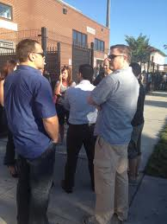
Once Outside
Establish a Meeting Place
  Clear of arriving emergency equipment
Head Count
  Take multiple headcounts
  Account for visitors & outside contractors

Slide 68
Regulatory Requirements
Personal Protective Equipment (PPE)

Slide 69

Equipment Owners Manual & Warning Labels
If the owner’s manual states that specific PPE should be worn, then employees must use that PPE
Manufacturer recommendations are enforceable by NJPEOSH under the General Duty Clause
Notes:
You DID read the Owner’s Manual, didn’t you?

Slide 70
Complete Job Hazard Assessment
Must be in writing
  Who, when & where
  Certified (signed)
For all job tasks
Identify the hazards
Identify control measures or safeguards
Notes:
These are many different forms to help identify where hazards exist. This is one of the forms used by JA Montgomery.

Slide 71

If Personal Protective Equipment is the Control Measure . . .
The employer must:
Select proper types & sizes of PPE
Communicate selection decisions
Provide and pay for PPE
Notes:
Employers must conduct a Hazard Assessment. This must be documented. Employees must be made aware of the requirements. Page 2 (or back) of the certificate provides the necessary documentation.

Slide 72

Exceptions to Employer-Paid PPE
  Protective-toed footwear
  Prescription safety glasses
  Employee purchased specialty PPE
  Everyday clothing used as PPE
    Long sleeves to protect from poison ivy
  Lost or intentionally damaged PPE
Notes:
From Federal Register November 15, 2007
Employers are responsible for paying for the minimum level of PPE required by OSHA standards.
If an employer decides to use upgraded PPE , the employer must pay for that PPE.
If an employer provides PPE at no cost and an employee asks and is permitted to use a different PPE, the employer is not required to pay for the item.
Exceptions:
Employers are not required to pay for non-specialty protective toed footwear and non-specialty prescription safety eyewear so long as the employee is allowed to wear these items off the job. Also, protective-toed boots are not the responsibility of the employer if metatarsal guards are provided by the employer.
At times, long sleeves or pants and similar everyday clothing could serve as PPE. Similarly, employers are not required to pay for everyday jackets, gloves, etc. Except if the workplace presents unusually severe environmental hazard such as walk-in freezers, the exception does not apply.
Employers must pay to replace PPE, except they are NOT responsible in limited circumstance in which an employee has lost or intentionally damaged the PPE. IN such cases, the employer may require the worker to pay the replacement cost.

Slide 73
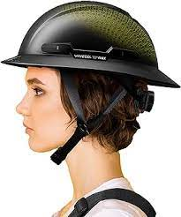
Head Protection Required When
Objects may fall from above and strike worker below
Workers may come in contact with energized electrical equipment
Inspect Hard Hat before each use
29 CFR 1910.135(a)
29 CFR 1926.100(a)
Notes:
Discussion Point:
OSHA General Industry only gives these general requirements. Employers must apply them to THEIR job tasks.

Slide 74
Eye Protection Required When
Eyes exposed to flying particles, molten metal
  Side guards also required
Liquid chemicals, acids, caustics
Chemical gases or vapors
Potentially injurious light
Check your Safety Glasses
Should be Z87.1-2003 or later
29 CFR 1910.133(a)
29 CFR 1926.102
Notes:
29 CFR 1910.133(a)(1) & (2)
Discussion Point:
Again, here the guidelines from OSHA for when glasses are required. What jobs do you do that require glasses?
2nd Click Discussion Point:
Remind every these are the MINIMUM standards, as written by lawyers. Do you want to trust your eyesight and your family well-being to minimum standards? Is wearing glasses more often a good idea?

Slide 75
Prescription Glasses
Are not safety glasses unless specifically labeled
Employer must provide suitable protection for workers with prescription lenses
  Incorporate prescription lenses in design
  Glasses which fit over prescription lenses
  Provide for mounting corrective lenses behind protective lenses
  New developments offer solutions

Slide 76
Hearing Protection
If workers are exposed to noise levels above 85 dBA TWA, they must be enrolled in Hearing Conservation Program
  Written Program & Audiometric testing
  Annual training; separate MSI class
Noise levels above 90 dBA, require PPE
  Employee education & enforcement
  Can’t be heard over noise at 3 feet
Notes:
In discussing hearing protection, employees must be aware of two levels of noise
OSHA has established an ACTION LEVEL for noise hazards at 85 dBA on a Time Weighted Average (TWA). At this noise exposure, workers must be protected from occupational noise. This includes being enrolled in a Hearing Conservation Program and requires annual training that goes beyond the scope of this program. There is a separate MSI Hearing Conservation class for those employees.
Whether workers are part of a Hearing Conservation Program or not, they must be protected from noise above 90 dBA. Hearing PPE is often the control measure of choice. Training is still needed, but not to the same level as under the HCP.

Slide 77
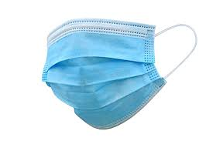
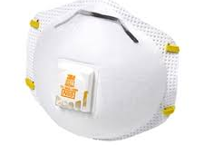
Understanding Respiratory PPE
N95 Respirator
Protects the wearer from contaminants in the environment
For patient-care use
  Training on donning / doffing
  Annual fit testing
Surgical mask
Protects the environment from contaminants of the wearer
For patient-care use
  No training is required

Slide 78
Voluntary Use of Respirators
If an employer determines employees are NOT exposed to air contaminants above PEL
Employer may provide respirators at employee’s request, or permit employees to use their own respirators, IF employer determines that such use will not create another hazard
If voluntary use is permissible, employer must provide users with the information contained in Appendix D
Notes:
MUC = Maximum Use Concentration = the maximum atmospheric concentration of a hazardous substance from which an employee can be expected to be protected when wearing a respirator, and is determined by the assigned protection factor of the respirator or class of respirators and the exposure limit of the hazardous substance. The MUC can be determined mathematically by multiplying the assigned protection factor specified for a respirator by the required OSHA permissible exposure limit, short-term exposure limit, or ceiling limit. When no OSHA exposure limit is available for a hazardous substance, an employer must determine an MUC on the basis of relevant available information and informed professional judgment.

Slide 79
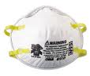
Voluntary Respiratory Protection Program
Program must be in writing
  Worker is medically able to wear respirator
    Medical evaluation is NOT required
    Worker understands physical demands of wearing a respirator
      Cardiac & pulmonary stresses
  Cleaning, storage, maintenance
  Only filtering respirators
    Trained on limitations of respirators
Notes:
Employers who permit voluntary use of respirators must still have a written RPP, though limited. RPP should include
ensuring the worker understands the physiological strains of using a respirator and is medically cleared to wear a respirator. The employer is NOT required to provide medical evaluations, but should get a note from personal physician.
give guidance on proper cleaning, storage, and maintenance on the permitted respirator so that the respirator does not become a hazard due to dirtiness, contamination, over-use, etc.
Most Importantly – make sure the employee truly knows the limitations of the permitted respirator. Using the wrong filter or using in a IDLH atmosphere can kill the worker if they make a mistake.
OSHA provides an exception to the written RPP rule if the employer only allows dust masks on a voluntary use.

Slide 80



ANSI Traffic Vests
ANSI Class 1
  Parking lots/Sidewalks
ANSI Class 2
  On or near roadway
ANSI Class 3
  High speed roadways
  Low visibility
  Dawn/dusk
Notes:
Manual of Uniform Traffic Control Devices 2009 edition is the law in New Jersey effective January 2010
Chapter 6D.03 is relevant section.

Slide 81
Glove Selection
Not all gloves are created equal
Ensure the glove will protect from the specific hazards of the job
Chemical gloves do not last forever… Understand the chemical and “break-through” characteristics of your specific glove
Consider barrier creams for:
  poison ivy
  petroleum products

Slide 82
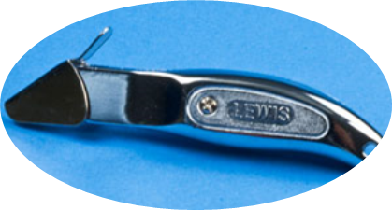

Safety Knives
Invest in safety knives
Models available for most tasks

Slide 83
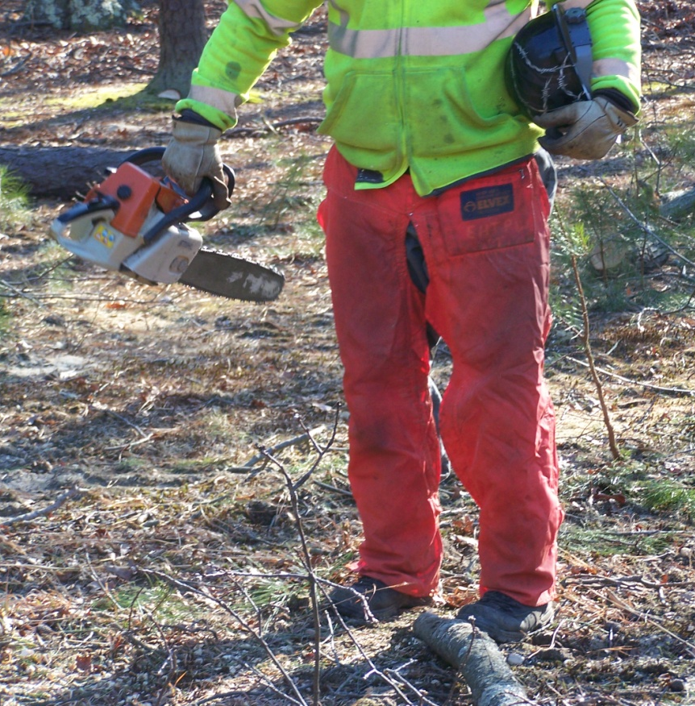
Chaps With Chainsaw
Chainsaw operators shall wear leg protection
  Cut-resistant material, such as ballistic nylon
  Cover the thigh to the top of the boot
Exceptions:
  Climbers
  In bucket trucks
29 CFR 1910.266(d)(1)(iv)
Notes:
The logging Chapter applies to municipal operations.
Bottom line – unless the chainsaw operator is in a bucket truck (the bucket is the protection), or if a climber determines chaps create a bigger hazard than the chainsaw, chaps are needed.
Choosing material is important. Riding chaps are not acceptable. Must be chainsaw chaps of ballistic nylon or Kevlar.

Slide 84

Protective Footwear Required When
Feet are exposed to dangers caused by
Rolling or falling objects
Objects piercing sole
Electrical hazards
29 CFR 1910.136(a)
29 CFR 1926.

Slide 85

Slip Prevention
Slip-Trip-Fall are the 2nd highest cause of injuries
Shoes are a major factor in slips
Proper condition and material of soles is critical
Should be part of JSO and
routine PPE inspections
Notes:
A consultant asked bulk waste collectors to show them their shoes’ soles to check their condition. The crew had experienced a couple of injuries over the recent past history.

Slide 86
PPE Storage
Chainsaw chaps in cabinet
Store in clean, well-ventilated areas
Store away from UV rays, harmful chemicals, dust, etc.
Easily accessible
Chainsaw cabinet

Slide 87
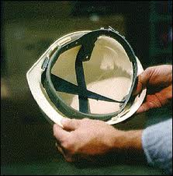
Periodic Inspection of PPE
Employers must ensure PPE is in a “sanitary & reliable” condition
  Do not use defective PPE
Employers should conduct an annual PPE Inspection
  Documented
Notes:
1910.132(a) Application. Protective equipment, including personal protective equipment for eyes, face, head, and extremities, protective clothing, respiratory devices, and protective shields and barriers, shall be provided, used, and maintained in a sanitary and reliable condition wherever it is necessary by reason of hazards of processes or environment, chemical hazards, radiological hazards, or mechanical irritants encountered in a manner capable of causing injury or impairment in the function of any part of the body through absorption, inhalation or physical contact.1910.132(b) Employee-owned equipment. Where employees provide their own protective equipment, the employer shall be responsible to assure its adequacy, including proper maintenance, and sanitation of such equipment.

Slide 88

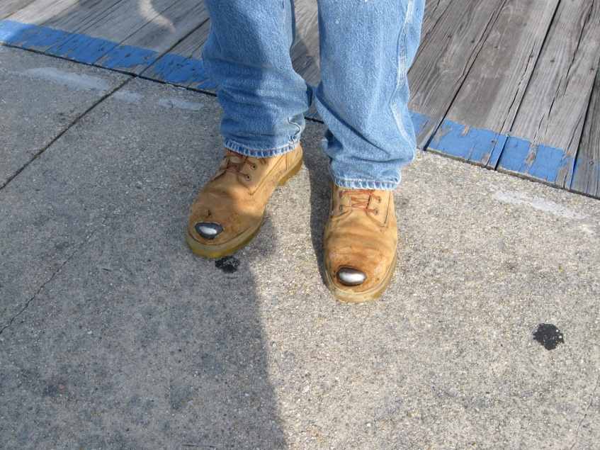
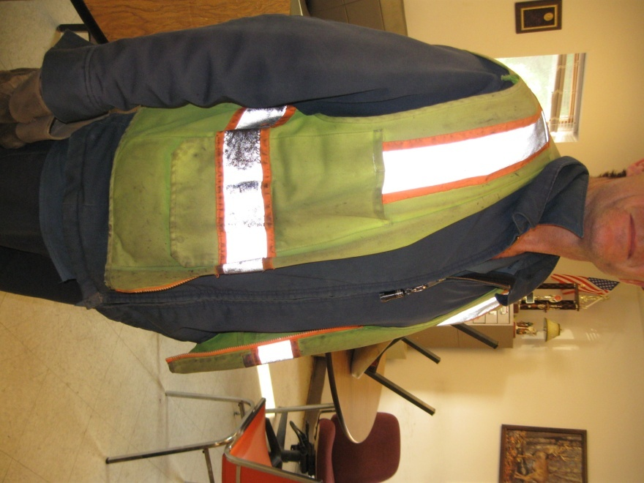
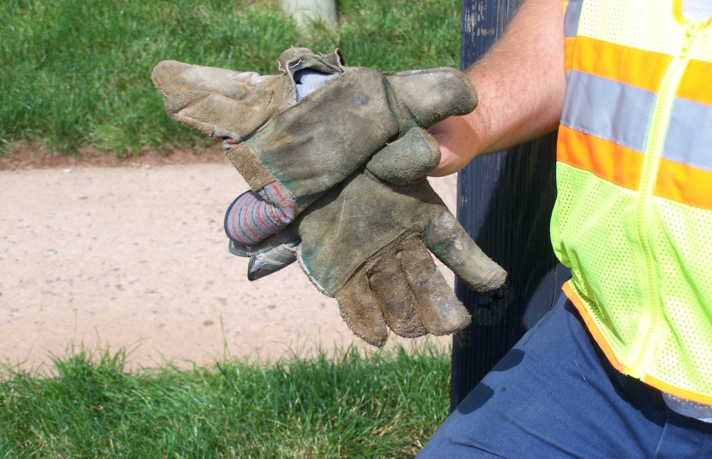
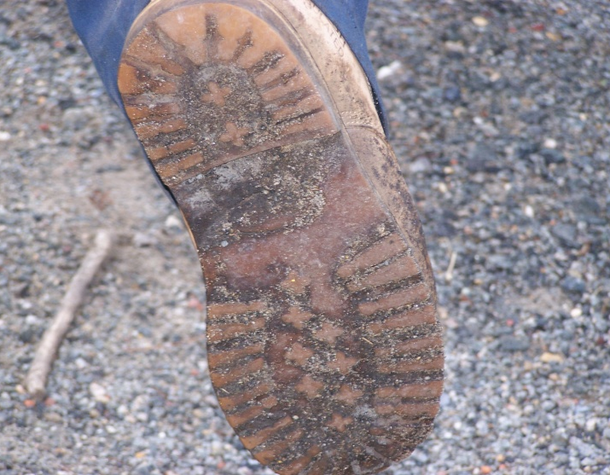
Defective PPE SHALL not be used
29 CFR 1910.132(e)
Notes:
Left side pictures: worn and ripped gloves
Right side pictures: worn toes and soles of work boots
Center picture: badly soiled hi-vis vest

Slide 89
Regulatory Requirements
Asbestos, Lead & Silica

Slide 90
Buildings Built Before 1978 & 1980
Up to 1978: Lead paint & solder
Up to 1980: Asbestos
Silica-containing materials are still used extensively

Slide 91

Asbestos
Naturally-occurring minerals
Asbestos fibers:
  Much finer than human hair, spider web or glass wool
Friable vs. Non friable
Fibers:
Stay airborne for extended periods
Reach the deepest part of the lung if inhaled
Notes:
The very small asbestos fibers become easily airborne and stay airborne for extended periods. The fibers can be inhaled and reach the deepest parts of the lungs.

Slide 92

Employers Must
Communicate Hazard
Must presume thermal insulating materials are ACM (in pre-1980 buildings), until analyzed.
Must presume asphalt & vinyl floor materials are ACM (in pre-1980 buildings), until analyzed.
Employers must train workers who may come in contact with ACM or Presumed Asbestos Containing Materials (PACM).
Inform contractors of ACM & PACM.
Maintain records of presence and tests of ACM & PACM.
Notes:
Certain materials must be PRESUMED to contain asbestos, until material analyzed and shown NOT to contain asbestos fire

Slide 93
Asbestos Training for Employees
The employer shall provide asbestos awareness training to employees who perform housekeeping work in areas where ACM and/or PACM is present.
Each such employee shall be so trained at least once a year.
Training includes:
  Health effects of asbestos
  Locations of ACM and PACM in the building/facility
  Recognition of ACM and PACM damage
  Proper response to fiber release episodes
Notes:
1910.1001(j)(7)(iv)The employer shall also provide, at no cost to employees who perform housekeeping operations in an area which contains ACM or PACM, an asbestos awareness training course, which shall at a minimum contain the following elements: health effects of asbestos, locations of ACM and PACM in the building/facility, recognition of ACM and PACM damage and deterioration, requirements in this standard relating to housekeeping, and proper response to fiber release episodes, to all employees who perform housekeeping work in areas where ACM and/or PACM is present. Each such employee shall be so trained at least once a year.

Slide 94

Work Controls for ACM & PACM
Working with or around ACM or PACM requires special tools and training.
Some minor tasks may be performed by non-certified, but properly trained and equipped, workers.
HEPA vacuum
Notes:
The rules and regulations for working with asbestos, asbestos containing materials, or potentially asbestos containing materials are complex. Before beginning ANY WORK that may disturb asbestos containing materials, contact a qualified or certified technician for guidance.
Any asbestos abatement work MUST be performed by a qualified vendor.

Slide 95
Tasks with Potential Silica Exposure
Activities
Sawing
Chipping
Drilling
Grinding
Crushing
Polishing
Clean-up
Sand blasting
Materials
Asphalt
Brick
Concrete & mortar
Granite
Joint compound
Pavers & blocks
Terrazzo
Tile & grout
Notes:
Obviously, most PW (Road Dept.), Facilities (Buildings & Grounds) and Utility workers do at least some of these tasks. So this section is for YOU.

Slide 96

Silica Dust
Visible dust contains large particles (easy to see) and tiny, respirable (invisible) particles
Notes:
Large dust particles are mostly trapped by nose hair, mucous in nasal cavity and throat, and . It’s the tiny particles that get past the body’s defenses and get lodged in the tissues of the lung.

Slide 97

Effects of Overexposure
Silicosis
Chronic → 10+ years of exposure
Accelerated → 5-10 years of exposure
Acute → weeks or months of
extreme exposure
Lung Cancer
Colored X-ray of lungs with silicosis
Notes:
There are 3 types of Silicosis:
Chronic silicosis, the most common type, usually occurs after 10 or more years of exposure to crystalline silica at low levels
Accelerated silicosis occurs 5 – 10 of exposure to higher levels of crystalline silica
Acute silicosis can occur after only week or months of exposure to very high levels of crystalline silica. It can progress rapidly and can be fatal within months
Crystalline silica is classified by OSHA as a human lung carcinogen.
Over-exposure can also cause SILICOSIS – Silicosis is the scarring of lung tissue, thus reducing the lung’s ability to take in oxygen. It is irreversible and there is no cure. It can be debilitating, lead to lung infections such as tuberculosis, and even death.

Slide 98

Drywall Mud
Hand sanding can produce 143 mg / m³ air
Purchase silica-free joint compound
  Check SDS
  Look for ‘crystalline silica’ or ‘quartz’ in ingredients
Use wet sponges
  Clean well after use
Always Minimize Dust!
Notes:
Substituting a safer material is the most-preferred control measure under OSHA’s Hierarchy of Controls. Using a silica-free compound should be routine. Specify this on purchase orders and contracts with vendors. Verify by checking MSDS sheets and not manufacturer or vendor claims.
If a silica-free compound is not possible, at least choose a compound that contains the minimum silica content.
Using a wet sponge to smooth joint compound is another best practice.
Be sure to rinse the sponge often so as not to smear dust that will later become airborne.
Use the least amount of strokes.
Thoroughly clean sponges and buckets after each use so the dry residue does not create a hazard.
Sponging also offers other advantages: less clean-up, wallboard is not scuffed, and offers a smoother surface for painting.
A vacuum system is also available, but relies heavily on clean filters.
As a last resort, the use of poles has been shown to offer a level of protection over hand sanding with a block.

Slide 99

Tasks with Potential Lead Exposure
Painting and paint prep (lead in paint pre-1978)
Repairing old water pipes
Welding
Notes:
Vehicle parts: Batteries, radiators and electronics
Firing Ranges: handling lead ammunition which may result in lead in soil
Paint was commonly in used in paint until 1978 – home, office, playground
lead can also leach into the ground soil from the above
Relate to home & families: some workers may make their own fishing weights & lures or reload ammo. Also, imported cosmetics have been found to sometimes contain lead and other heavy metals (relate to home)

Slide 100
Lead - Effects of Overexposure
Acute over-exposure in adults can lead to:
Abdominal pain and constipation
Excessively tired or body weakness
Headache, memory loss, tremors, or seizures
Pain or tingling in the hands and/or feet; can also manifest as wrist drop
Teratogen (affects developing fetus)
Lead exposure in children can lead to severe neurological damage
Notes:
It does not matter if a person breathes in, swallows, or absorbs lead particles, the health effects are the same; however, the body absorbs higher levels of lead when it is breathed in.
Within our bodies, lead is absorbed and stored in our bones, blood, and tissues. It does not stay there permanently, rather it is stored there as a source of continual internal exposure. As we age, our bones undergo demineralization and the internal exposures may increase as a result of larger releases of lead from the bone tissue.
Health effects from short-term overexposure to lead
Lead poisoning can happen if a person is exposed to very high levels of lead over a short period of time. When this happens, a person may feel:
Abdominal pain and constipation
Excessively tired or weakness
Headache, memory loss, tremors, or seizures
Loss of appetite or sex drive
Pain or tingling in the hands and/or feet; can also manifest as wrist drop
Because these symptoms may occur slowly or may be caused by other things, lead poisoning can be easily overlooked as their cause. Being exposed to high levels of lead may cause anemia, weakness, and kidney and brain damage. Very high lead exposure can cause death.
Lead can cross the placental barrier, which means pregnant women who are exposed to lead also expose their unborn child. Lead can damage a developing baby’s nervous system. Even low-level lead exposures in developing babies have been found to affect behavior and intelligence. Lead exposure can cause miscarriage, stillbirths, and infertility (in both men and women).
Generally, lead affects children more than it does adults. Children tend to show signs of severe lead toxicity at lower levels of lead than adults. Lead poisoning has occurred in children whose parent(s) accidentally brought home lead dust on their clothing. Neurological effects and mental retardation have also occurred in children whose parent(s) may have job-related lead exposure.

Slide 101
Chronic (Long Term) Effects
Lead toxicity can affect every organ system
The nervous system is the most sensitive target
  Dullness, irritability, poor attention span, muscular tremor, and loss of memory.
Many studies show a strong association between lead exposure and renal (kidney) effects.
Lead poisoning also affects blood (hemoglobin), gastrointestinal, and reproductive systems
Notes:
Lead encephalopathy (abnormal brain function or brain structure) may occur at extremely high blood lead levels.
Precursors of encephalopathy, such as dullness, irritability, poor attention span, muscular tremor, and loss of memory may occur at lower blood levels.
decreased libido
depression/mood changes
diminished cognitive performance
diminished hand dexterity
diminished reaction time
diminished visual motor performance
dizziness
fatigue
There is also some evidence that lead exposure may affect adults' postural balance and peripheral nerve function.
Renal Effects Many studies show a strong association between lead exposure and renal effects. (ATSDR 1999)
Continued or repetitive exposures can cause a toxic stress on the kidney, if unrelieved, may develop into chronic and often irreversible kidney damage.

Slide 102
Working with Lead-based Paint
Assume pre-1978 paint contains lead
Avoid creating or spreading dust & fumes
  Use low dust practices
    Avoid sanding, scraping, & burning
  Use respiratory protection
Protect occupants & workers
  Wash hands often
  Do not eat, drink, or smoke when working with lead
  Avoid taking dust home
Clean-up properly

Slide 103

Removing Lead-based Paint
Do not use high speed sanders or grinders
  Unless with HEPA vacuum
Do not use open flame or heat gun or HIGH setting
  Creates toxic fumes
Do not use uncontained abrasive blasting
Avoid excessive dry scraping or sanding

Slide 104
Common Hazards

Slide 105
Maintenance Lost Time Injuries
Machine-Related 35%
Slips & Falls 31%
Strains & Sprains 30%
All Other Causes 4%
Notes:
Most accidents involving school custodians fall into three categories:
Machinery, Tools and Equipment – 35%
Slips and Falls – 31%
Strains and Sprains including back injuries – 30%

Slide 106

Tools & Equipment Safety
5 Basic Rules
Know and follow manufacturer’s instructions
Keep in good working order
Use only for the intended purpose
Examine for damage before every use
Wear appropriate personal protective equipment (PPE)
Notes:
There are five basic rules when operating machinery or using tools and equipment:

Slide 107


Provide Training on Equipment
Training and Retraining Needs
  Consider skill sheets as documentation
Enforcement and Reinforcement
  Job Observations
  Coaching
Notes:
Walk behind mowers present hazards. Do not underestimate the safety measures that are needed to operate them.
It may be convenient to assume EVERYONE knows how to push a lawnmower. But how many teenagers have never cut their homes’ grass? The number who haven’t is growing. Even if they have, the commercial or industrial mowers used at schools are different than those of the typical residential lawnmower.
New workers must be properly trained on department’s mowers. But once is not enough. Retraining is recommended by NJPEOSHA, typically every 3 – 5 years.
Proper mowing procedures should be verified through Job Site Observations. Reinforce good behaviors. Correct undesirable behaviors. Use progressive discipline if necessary.

Slide 108
Snow Removal & Salting
Document Snow Removal and Salting
  Day
  Time
  Location
Employee Training

Slide 109
3 Factors of a Slip Hazard
Footwear
Quality of foot-surface contact
Walking surface
Notes:
Let’s look at each

Slide 110
Periodic Facility Inspections
Damaged carpet
Extension cords in walking paths
Obscure transitions
  Step-downs
  Cracks in walkways
Storage in walking paths
Exasperating Conditions
Poor lighting
Loose handrails
Rushing

Slide 111
Ladder Safety
Ladders must be inspected before initial use in each work shift.
Any ladder with structural or other defects is immediately tagged "Dangerous: Do Not Use" and removed from service until repaired/ replaced.
Annual ladder inspection program is recommended
  Need to double check

Slide 112
Best Practice
Only Purchase Type 1AA Ladders
 | Type | Weight Limit *
Light Duty | 3 | up to 200 lb.
Medium Duty | 2 | up to 225 lb.
Heavy Duty | 1 | up to 250 lb.
Extra Heavy Duty | 1A | up to 300 lb.
Extra Heavy Duty | 1AA | up to 375 lb.
Notes:
The Safety Director of all JIFs recommend employers only purchase Type 1AA ladders for their workplaces.
ASK: What advantages does this provide to the employee and the employer?

Slide 113
Fixed Ladders
Fixed ladders that extend more than 24 feet:
Existing Fixed Ladders: Fixed ladders installed before November 19, 2018 will be equipped with a personal fall arrest system, ladder safety system, cage, or well.
New Fixed Ladders: Fixed ladders installed on and after November 19, 2018, will be equipped with a personal fall arrest system or a ladder safety system.
Notes:
https://www.osha.gov/laws-regs/regulations/standardnumber/1910/1910.28
For fixed ladders that extend more than 24 feet (7.3 m) above a lower level, the employer must ensure:
1910.28(b)(9)(i)(A)Existing fixed ladders. Each fixed ladder installed before November 19, 2018 is equipped with a personal fall arrest system, ladder safety system, cage, or well;
1910.28(b)(9)(i)(B)New fixed ladders. Each fixed ladder installed on and after November 19, 2018, is equipped with a personal fall arrest system or a ladder safety system;
1910.28(b)(9)(i)(C)Replacement. When a fixed ladder, cage, or well, or any portion of a section thereof, is replaced, a personal fall arrest system or ladder safety system is installed in at least that section of the fixed ladder, cage, or well where the replacement is located; and
1910.28(b)(9)(i)(D)Final deadline. On and after November 18, 2036, all fixed ladders are equipped with a personal fall arrest system or a ladder safety system.

Slide 114
Fixed Ladders
Fixed ladders that extend more than 24 feet:
When a fixed ladder, cage, or well, or any portion of a section thereof, is replaced, a personal fall arrest system or ladder safety system must be installed in at least that section of the fixed ladder, cage, or well where the replacement is located.
Final deadline: After November 18, 2036 all fixed ladders must be equipped with a personal fall arrest system or a ladder safety system.
Notes:
For fixed ladders that extend more than 24 feet (7.3 m) above a lower level, the employer must ensure:
1910.28(b)(9)(i)(A)Existing fixed ladders. Each fixed ladder installed before November 19, 2018 is equipped with a personal fall arrest system, ladder safety system, cage, or well;
1910.28(b)(9)(i)(B)New fixed ladders. Each fixed ladder installed on and after November 19, 2018, is equipped with a personal fall arrest system or a ladder safety system;
1910.28(b)(9)(i)(C)Replacement. When a fixed ladder, cage, or well, or any portion of a section thereof, is replaced, a personal fall arrest system or ladder safety system is installed in at least that section of the fixed ladder, cage, or well where the replacement is located; and
1910.28(b)(9)(i)(D)Final deadline. On and after November 18, 2036, all fixed ladders are equipped with a personal fall arrest system or a ladder safety system.

Slide 115

What is a Confined Space?
Must meet ALL THREE of the following:
Large enough & configured to allow entrance
Limited or restricted means of entry or exit
Not designed for continuous human occupancy
Notes:
The space must be large enough to physically enter to perform work. According to OSHA penetrating the opening of a confined space is considered an entry
So a 12” x 12” x 12” valve box for the field sprinkler system is not a confined space, even though it may present hazards to workers. It is just not a confined space.
The space must have limited or restricted means of entering or leaving the space. If a worker gains access through a set of normal stairs, or through a doorway, it is NOT a confined space. Again, some of the hazards may be present , but according to OSHA it is not a confined Space.
Restrictions may include: means of entry, where a ladder must be used to enter / exit, the opening is ‘small’ or made small with tools, etc., or the egress way is complex or convoluted. The fact that firefighters may be wearing a SCBA, or working in smoke, must be taken into consideration.
The space is not meant for workers to be in. These spaces are typically where processes are taking place, or materials are being stored. In a letter of interpretation (6/22/1995), OSHA writes,” OSHA proposes paragraph (b)(10)(iii) to make it clear that the work areas covered by this standard are unsuitable, by nature for continuous employee occupancy, because those spaces were created to contain such things as degreasers, sawdust, and sewage, not to accommodate people." Further, “OSHA believes that the final rule's definition properly places the focus on the design of the space, which is the key to whether a human can occupy the space under normal operating conditions.”
Under certain conditions A permit required confined space may be declassified as a non-permit required space.

Slide 116
Two Types of Confined Spaces
Permit Required
Spaces that contain or have the potential to contain a hazardous atmosphere or hazard capable of causing death or serious physical harm.
Non-Permit Required
Does not contain or have the potential to contain a hazardous atmosphere or hazard capable of causing death or serious physical harm.
Notes:
There are two types of confined spaces.
Permit Required and Non Permit required spaces. The part you have to remember is that the non permit required space can become a permit required space depending on the kind of work being performed or when conditions change.

Slide 117



Typical Permit Confined Spaces
Tanks
Wells
Manholes
Valve pits
Notes:
4
Each of these spaces could support a known or potential hazard

Slide 118
DO NOT ENTER
Employees should not enter permit-required confined spaces unless they are properly trained and equipped.

Slide 119
Control of Hazardous Energy (LOTO)
To prevent worker injury by preventing the unexpected re-start or release of energy
during repair, service, and set-up
by isolating equipment from the source of that energy
and verifying zero state of energy
Energy during normal operations is covered by OSHA Machinery & Machine Guarding rules
Notes:
Discuss the underlined parts of this definition

Slide 120
LOTO is Required During
Maintenance & general servicing
Repair
Inspections
Modifications
Adjustments
Set-up
Installations
Construction
Guards are removed
Notes:
The lockout/tagout standard applies to general industry employment and covers the servicing and maintenance of machines and equipment in which the unexpected start-up or the release of stored energy could cause injury to employees.

Slide 121
LOTO Employer Responsibilities
Employee Training
Annual Program Evaluations
Provide Proper LO/TO Equipment
Written LO/TO Program
Notes:
Employees can be, and often are, more than one. For example the operator of a vehicle is an Authorized Employee when they are performing the morning vehicle checks, adding oil or washer fluid, etc., but would be an Affected Employee when they give the vehicle to the mechanic for more intensive repairs.

Slide 122
Written LOTO Plan
Must Include:
Program Administrator & Responsible Individuals
Employee Classification, Responsibilities & Training
LOTO Devices & Distribution
  Individual locks or universal lockout kit
  Blocking & blanking equipment
Equipment-Specific Procedures
Special Situations Procedures
Notes:
Programs must be employer-specific. If you only do 1 or 2 of the activities on the previous slide, your program only has to include those activities.
If you do more of the activities, then you must address more.

Slide 123





Lock Out Tag Out Devices
  Electrical Energy
  Individual circuit breakers
  Plug boxes
  Wall switches
  Circuit breaker box
Notes:
Main purpose of this slide is to indicate that if employees see these devices they do not touch them remove them or alter them in any way.

Slide 124
Commercial Drivers License
CDL

Slide 125
Designated Employer Representative (DER)
The DER must be an employee of the agency and must have a complete understanding of the CDL controlled substances and alcohol testing procedures and the employer’s policies.
They must be available to receive confidential test results and other communications concerning the testing of employees.
Ideally, it would be preferable to appoint a supervisory employee from the department with CDL drivers as the principal DER and, an employee from the Human Resources or Administrative area as the backup.

Slide 126

Drug and Alcohol Testing
Reasonable Suspicion
Random Testing
Post Accident Testing

Slide 127

Clearinghouse
Secure online database that gives employers, the FMCSA, and State licensing agencies and law enforcement personnel real-time information about commercial driver’s license (CDL) and commercial learner’s permit (CLP) holders’ drug and alcohol program violations

Slide 128
Clearinghouse
The Employer Must Use the Clearinghouse to:
Conduct a full query of the Clearinghouse as part of each pre-employment driver investigation process.
Conduct limited queries at least annually for every driver they employ.
Request electronic consent from the driver for a full query, including pre-employment queries.
Report drug and alcohol program violations.
Record the negative return-to-duty (RTD) test results and the date of successful completion of a follow-up testing plan for any driver they employ with unresolved drug and alcohol program violations.

Slide 129
Resources
MEL Safety Institute (MSI) : melsafetyinstitute.org/
MSI LIVE Schedule: https://melsafetyinstitute.org/msi-live-schedule/
MSI Model Policies: https://melsafetyinstitute.org/model-policies/
NJ PEOSH: www.nj.gov/health/workplacehealthandsafety/peosh/

Slide 130

Thank You for Attending

